Slide 1


Slide 2
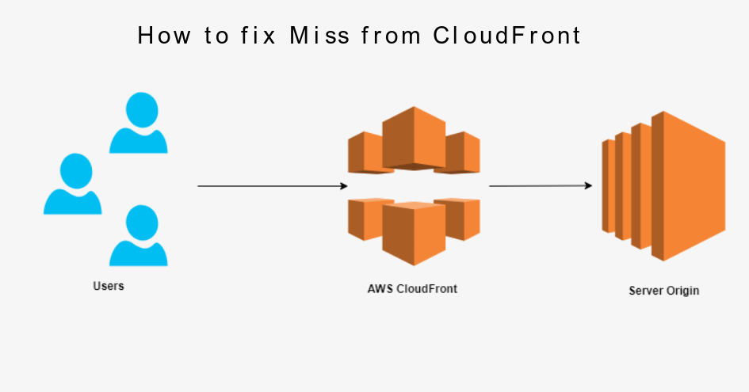

Slide 3
Amazon Cloudfront
Amazon Cloudfront is a webservice that gives business and web application developers an easy and cost effective way to distribute content with low latency and high data transfer speed
Amazon CloudFront is a fast content delivery network (CDN) service that securely delivers data, videos, applications, and APIs to customers globally with low latency, high transfer speeds, all within a developer-friendly environment.
Cloudfront is a global service .
Amazon Cloudfront is a webservice that speeds up distribution of your static & dynamic web content such as .html , .css , .js and image files to your users.

Slide 4
Amazon Cloudfront
Cloudfront delivers your content a worldwide network of data cemtre called edge locations.
When a user request content you are serving with cloudfront ,the user is routed via DNS resolution to the edge location that provides the lowest latency so that the content is delivered with the best possible performance.
If the content is already in the edge location with the lower latency , Cloudfront deliver it immediately.
Cloudfront also keeps persistent connection with origin server so files are fetched from the origin as quickly as possible.

Slide 5
Amazon Cloudfront
Edge locations:
An Edge location is basically a small setup in different locations that provides low latency connectivity by providing static contents to be available from nearest location of the request.
What happens is that instead of getting the information from the source it just routes to the nearest edge location and delivers the information reducing the latency
This way the access time is less and response is faster.

Slide 6
How caching works with CloudFront edge locations
One of the purposes of using CloudFront is to reduce the number of requests that your origin server must respond to directly. With CloudFront caching, more objects are served from CloudFront edge locations, which are closer to your users. This reduces the load on your origin server and reduces latency.
The more requests that CloudFront can serve from edge caches, the fewer viewer requests that CloudFront must forward to your origin to get the latest version or a unique version of an object. To optimize CloudFront to make as few requests to your origin as possible, consider using a CloudFront Origin Shield
The proportion of requests that are served directly from the CloudFront cache compared to all requests is called the cache hit ratio. You can view the percentage of viewer requests that are hits, misses, and errors in the CloudFront console

Slide 7


Slide 8
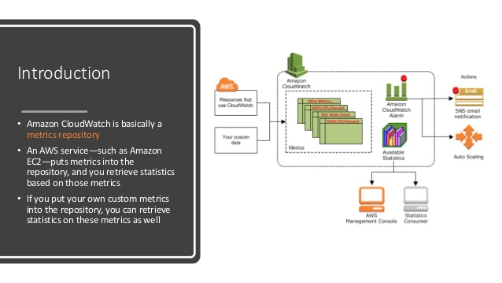

Slide 9
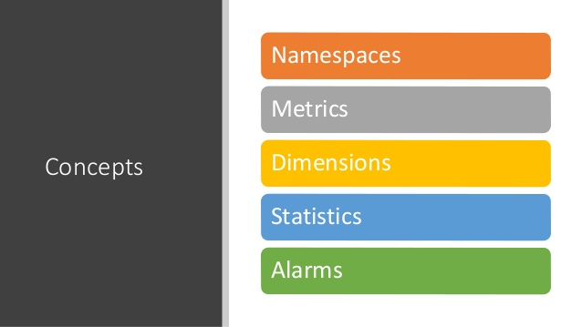

Slide 10
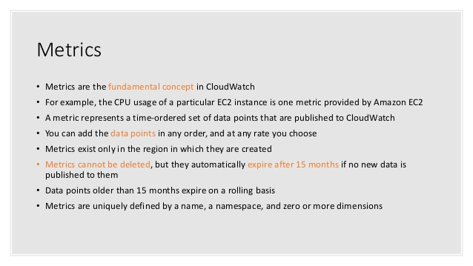

Slide 11
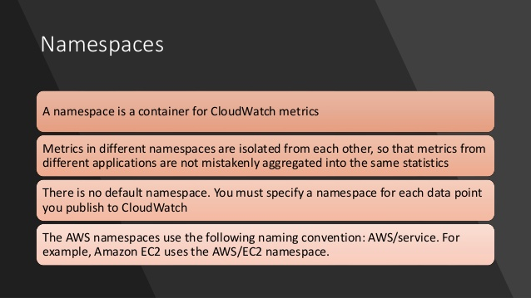

Slide 12
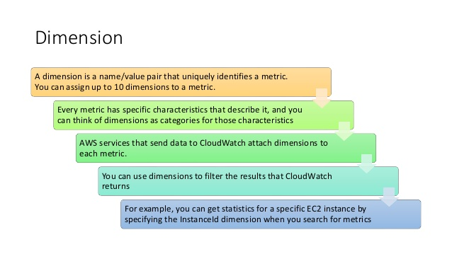

Slide 13
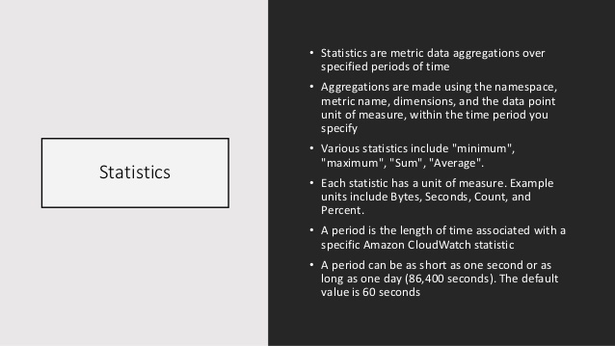

Slide 14
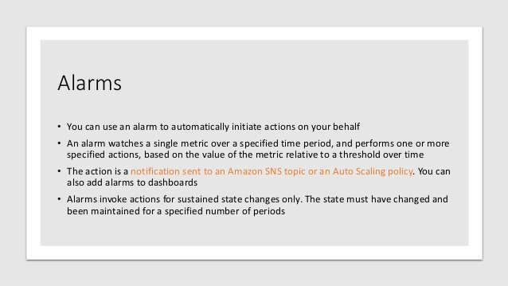

Slide 15
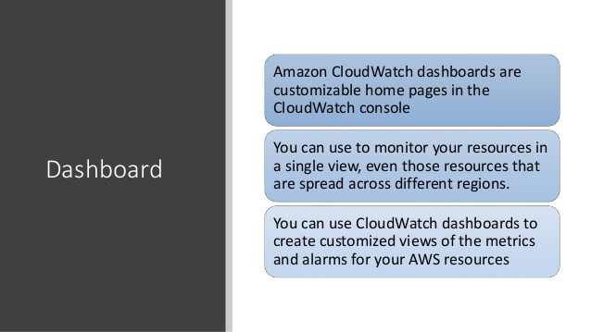

Slide 16
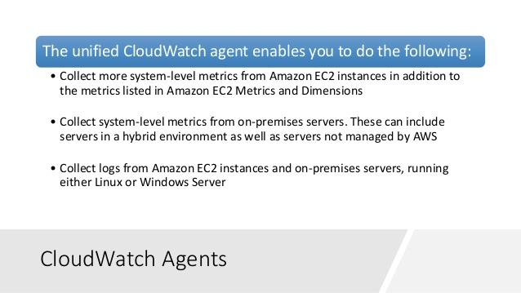

Slide 17
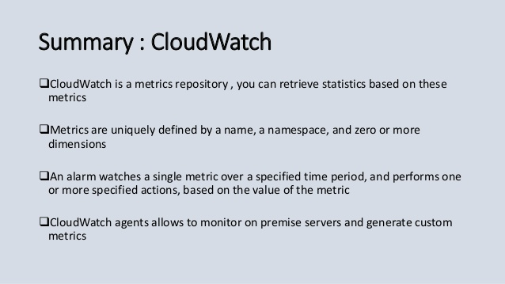

Slide 18
LAB SCENARIO
https://aws.amazon.com/premiumsupport/knowledge-center/start-stop-lambda-cloudwatch/
Create a solution which will run nginx across multiple AZ in daytime it should 2 servers and night time it should be 1.

Slide 19


Slide 20
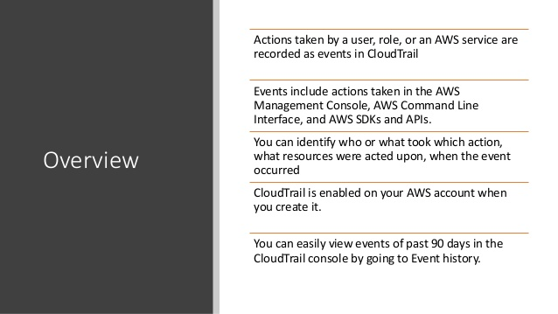

Slide 21
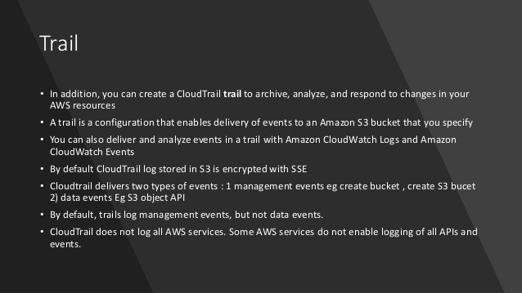

Slide 22
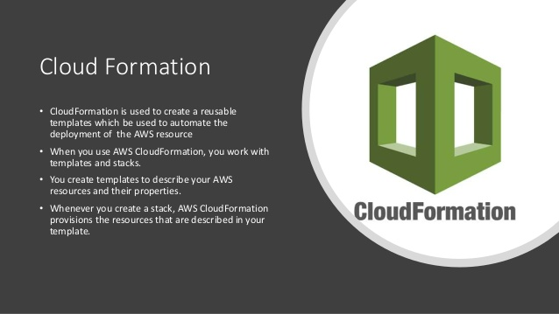

Slide 23
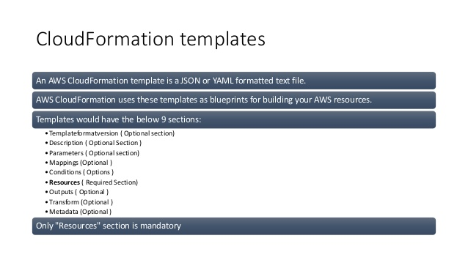

Slide 24
